Slide 1
ICEM
Residential Complex

Slide 2


SOFTWARE USED
2D DRAWINGS
3D MODELLING

Slide 3
Introduction
The project aims to design comprehensive 2D and 3D plans for a modern apartment complex.
The complex will consist of 12 towers, each standing at G+24 floors.
Every floor will feature a blend of 2BHK and 3BHK units, ensuring a diverse range of living spaces.
This Complex also contains an Club House with G+3 floor
As it comes to the Parking the 2 wheelers are given parking in the ground floor and all the 4 wheeler are given parking in the separate area in the middle of the plan .

Slide 4
Contents
Residential Complex Plan (984’6” x 538’ - 5,30,000 Sq. Ft)
Tower
Floor Plan (175’ 3” x 64’ 3” – 11,260 Sq. Ft)
2BHK ( 32’3” x 27’1.5”- 850 Sq. Ft).
3BHK (39’ x 27’1.5” -1030 Sq. Ft)
Club House (92’ x 52’ – 4,784 Sq. Ft)
Multilevel Parking (45,000 Sq. Ft)

Slide 5
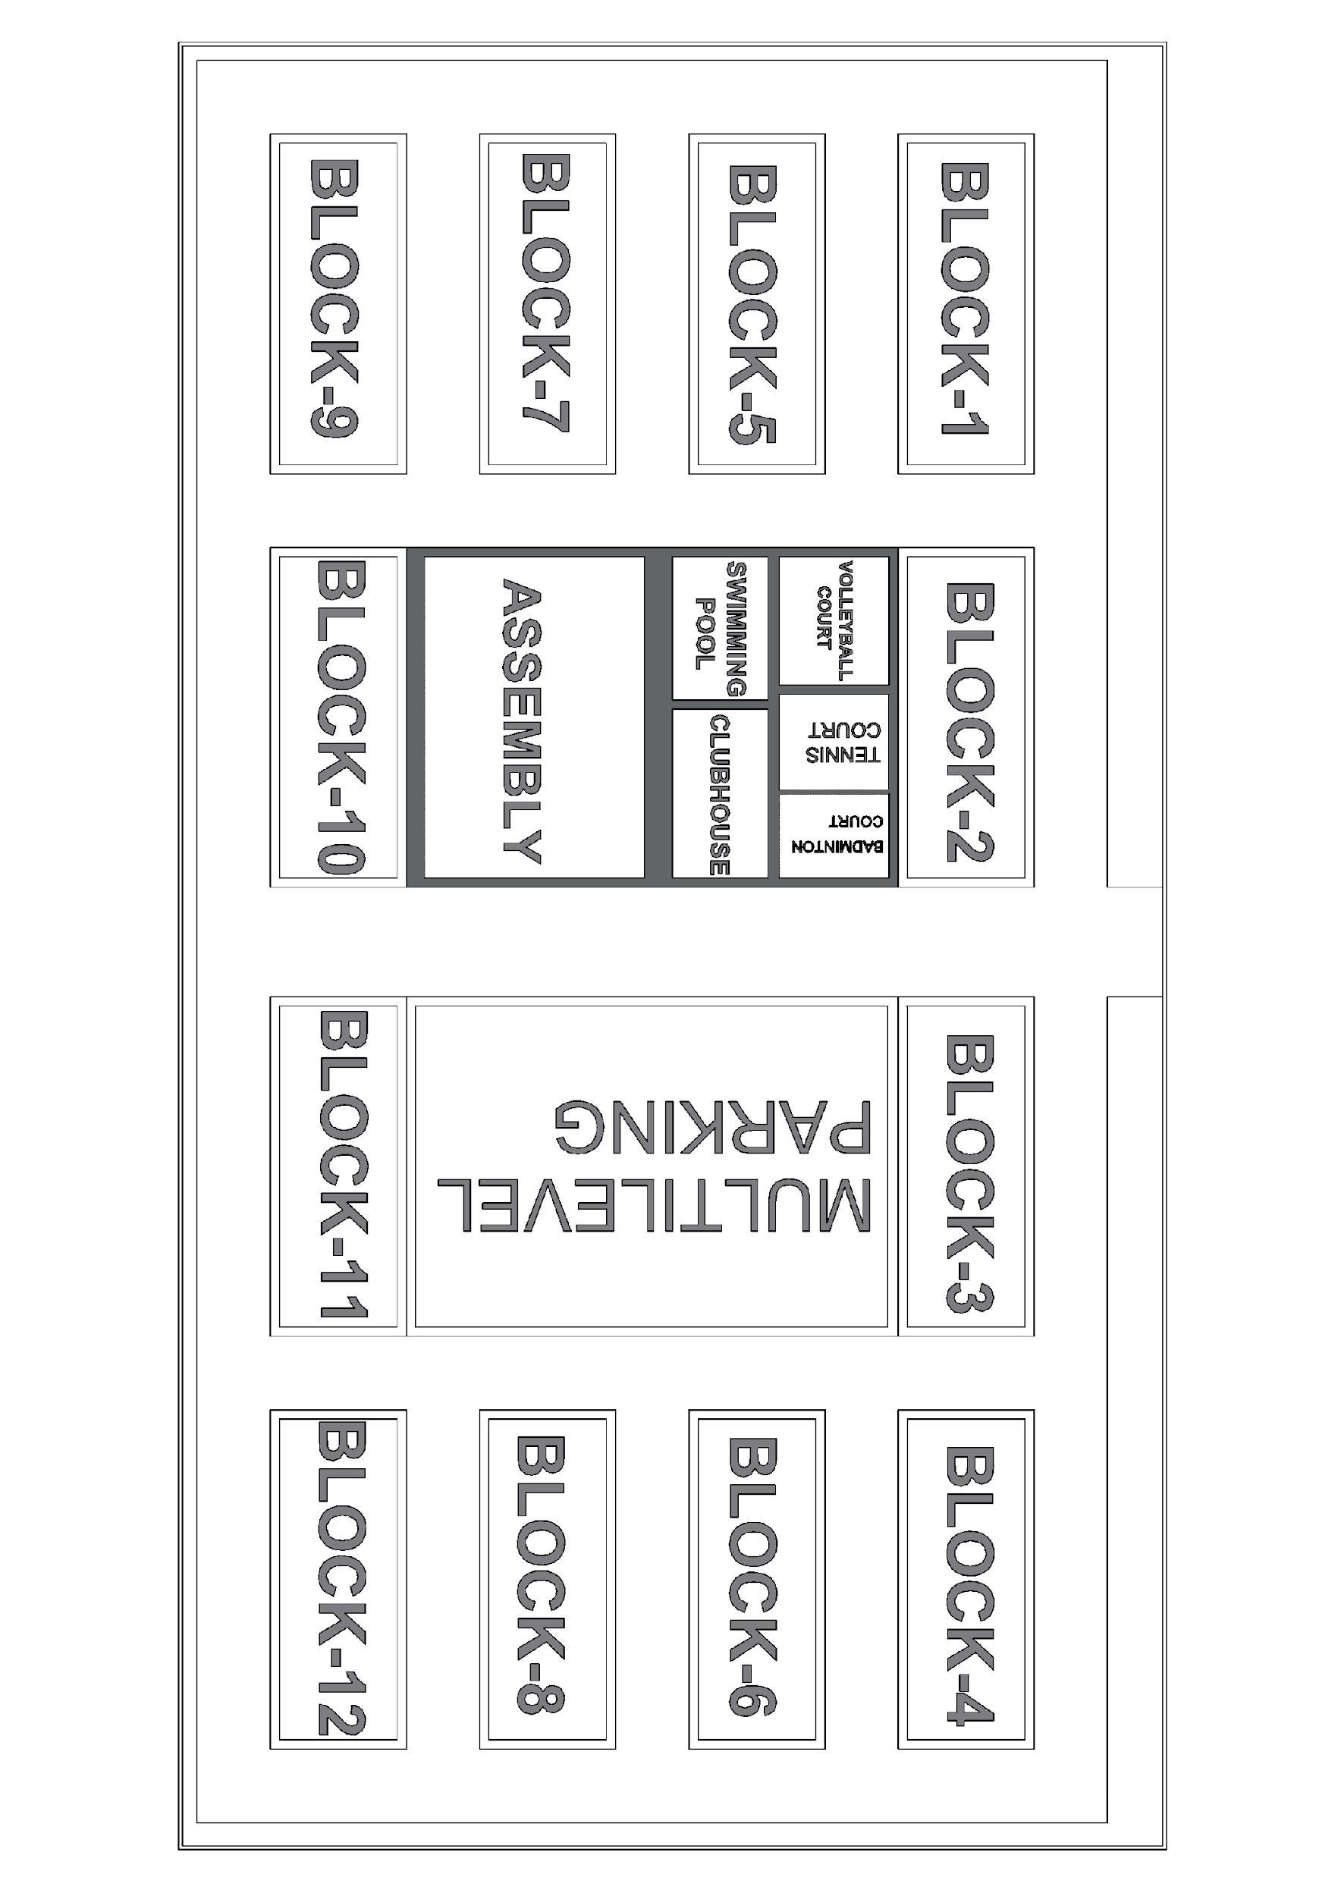
Total Project 2D plan

Slide 6
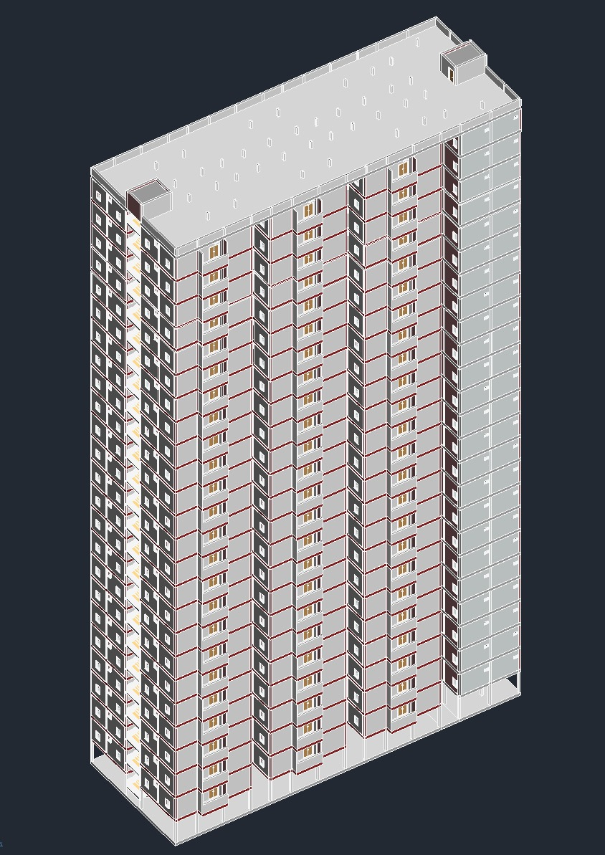
Full Block 3D Plan

Slide 7
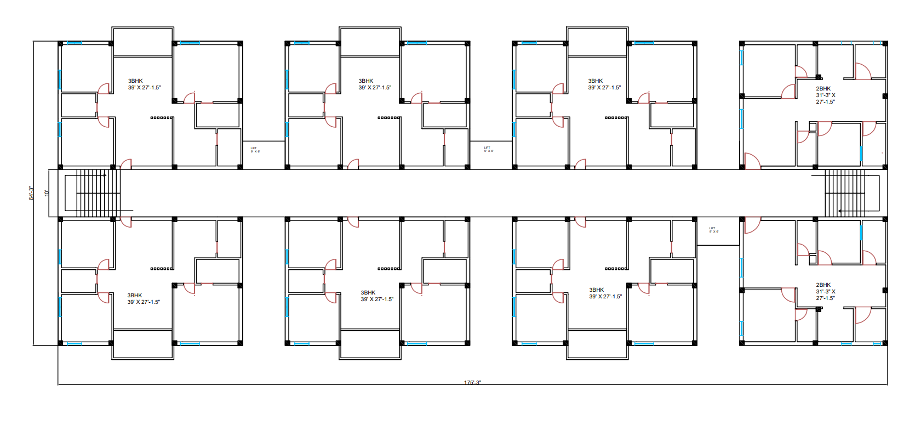
Floor Plan 2D

Slide 8
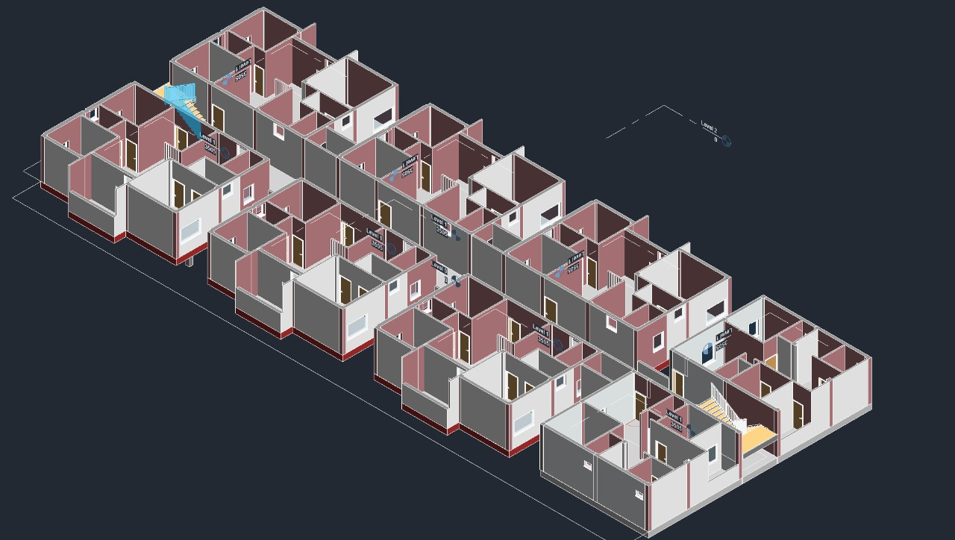
Floor Plan 3D

Slide 9
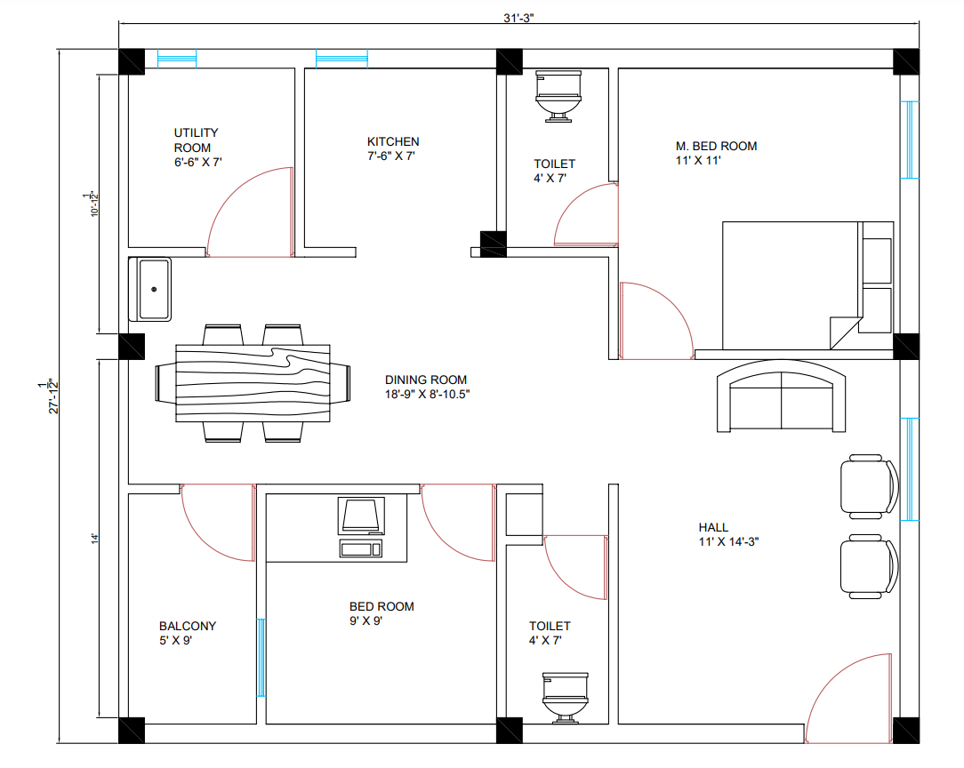
2BHK 2D

Slide 10
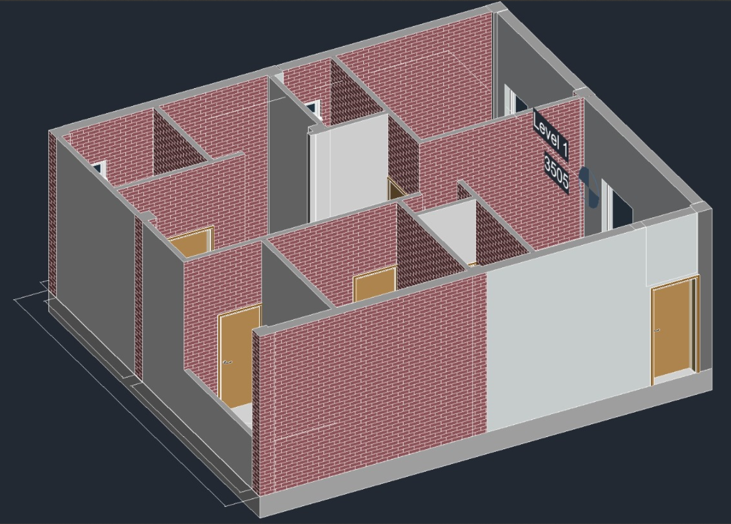
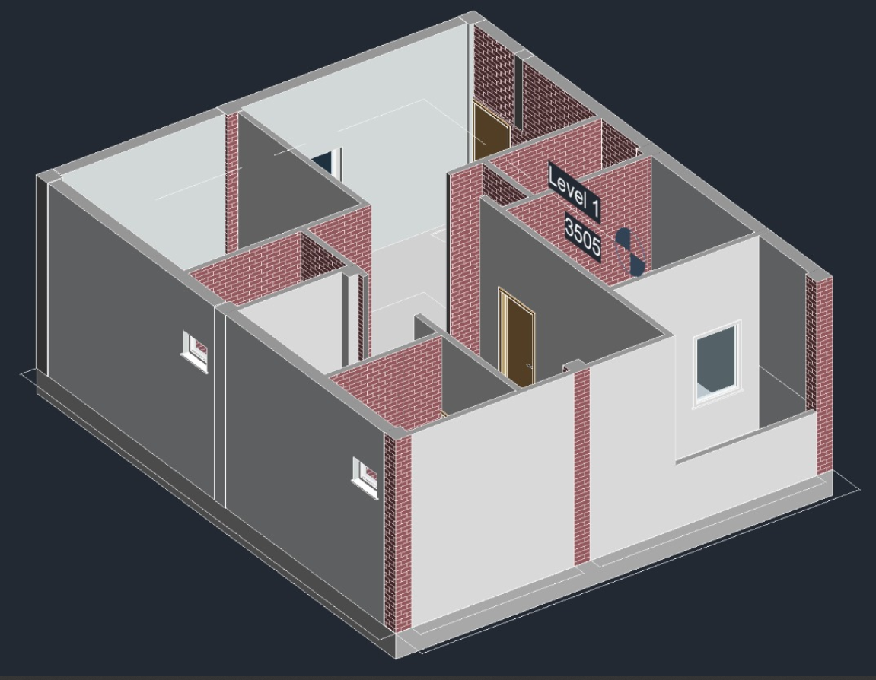
2BHK 3D

Slide 11
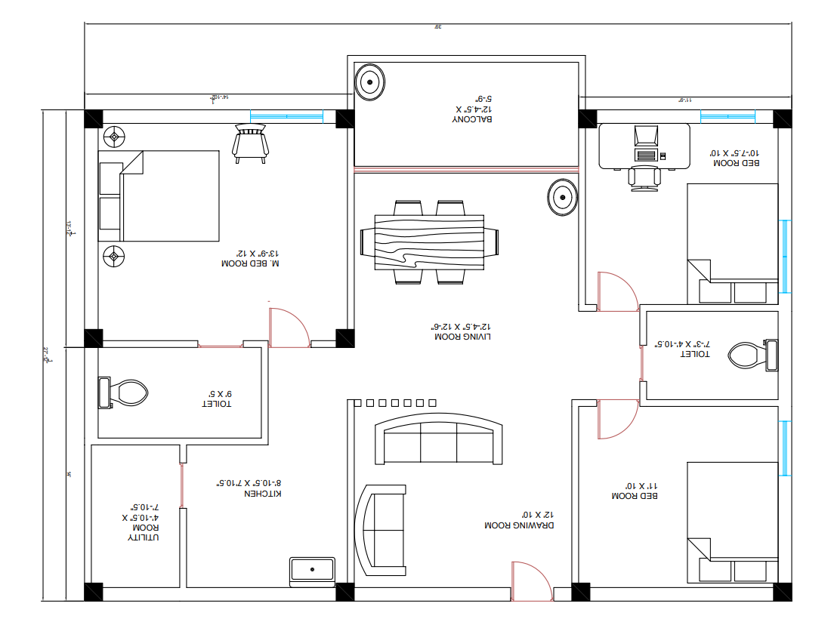
3BHK 2D

Slide 12
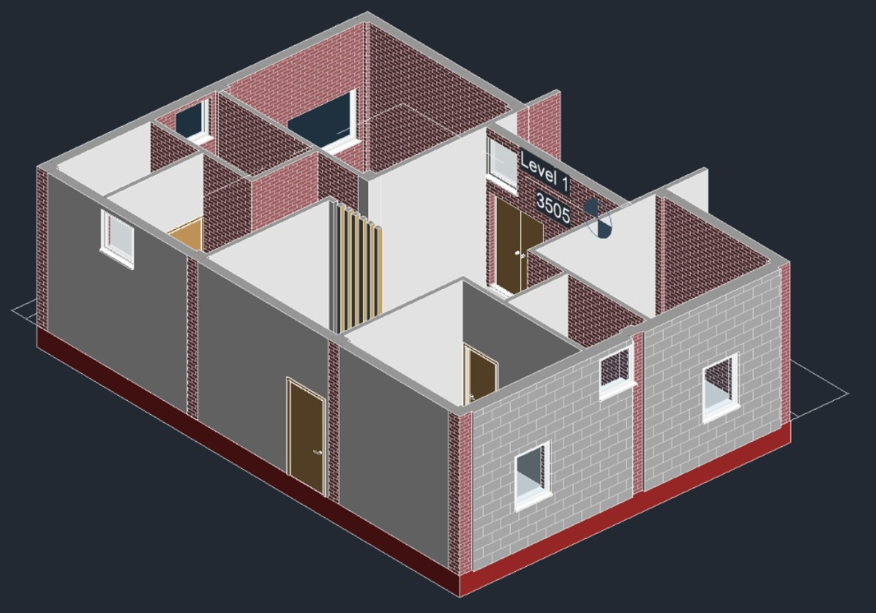
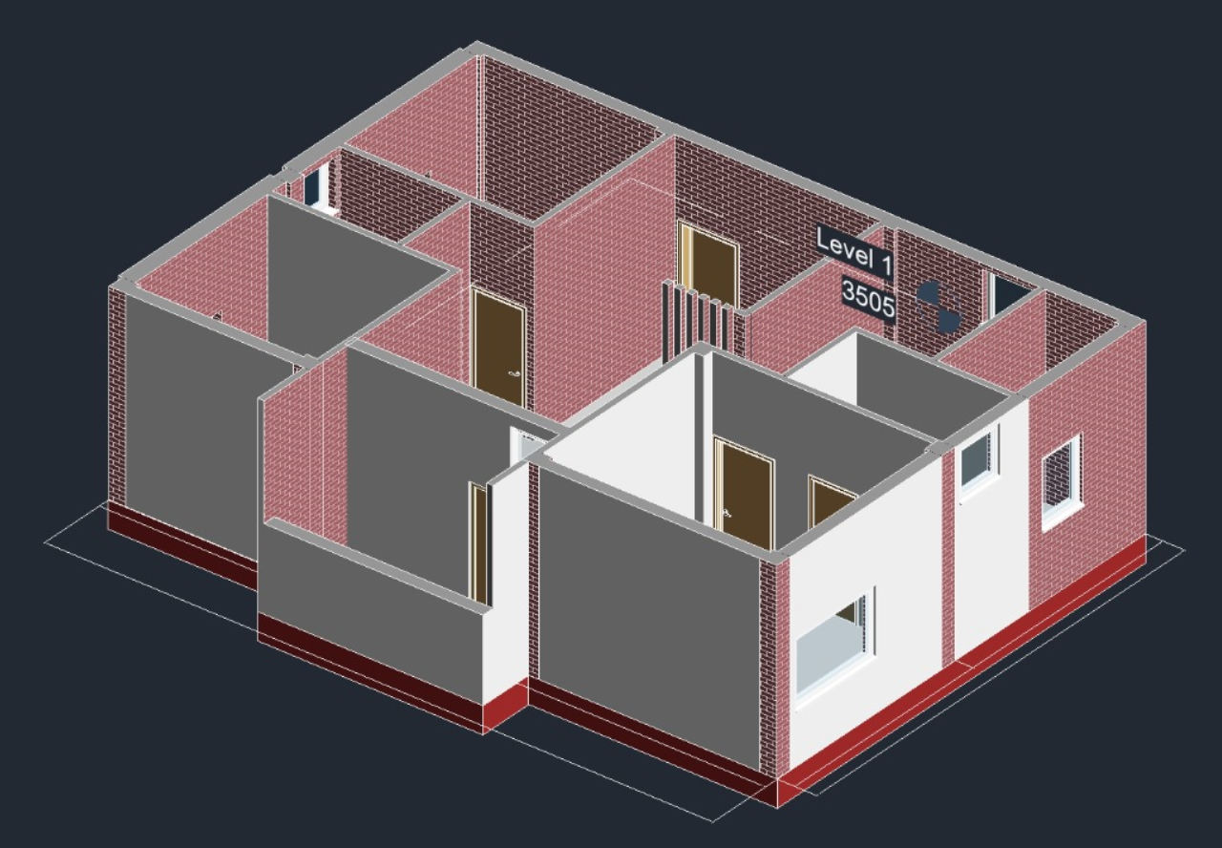
3BHK 3D

Slide 13
Club House
Club House Consists of G+3 Floors. It is used for many activities and contains different rooms for each. It consists :
Office
Sports Room
Movie Room
Banquet Hall
Restaurant
Library

Slide 14
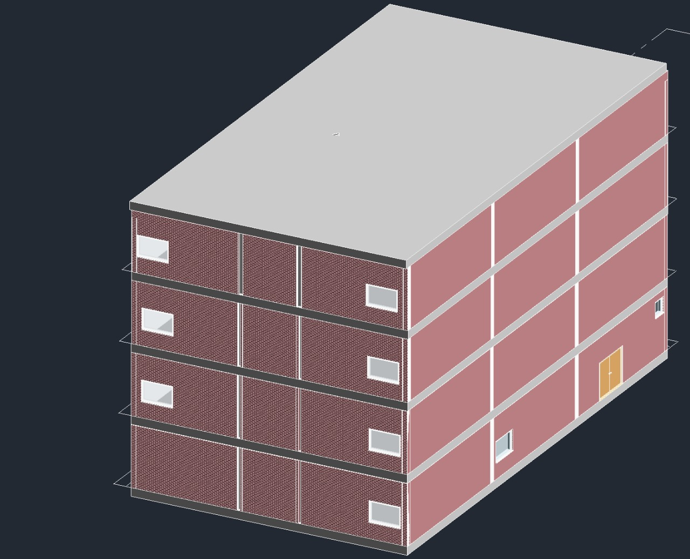
Club House 3D view

Slide 15
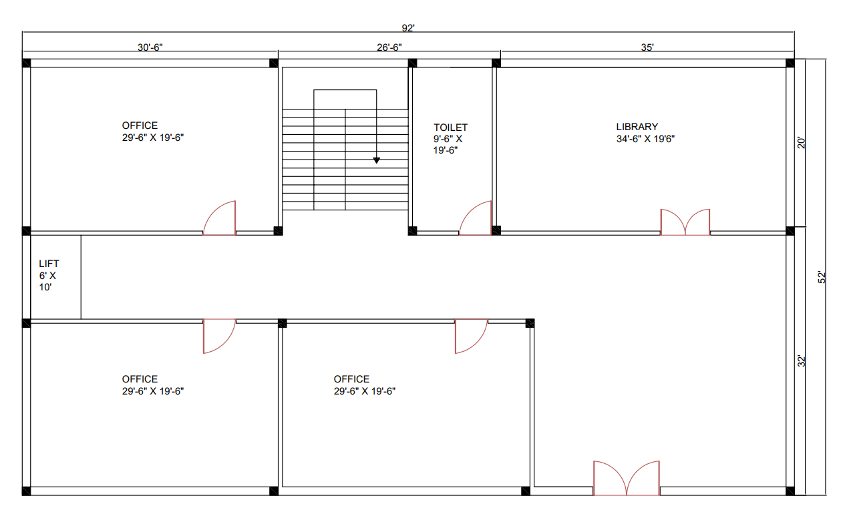
Club House Ground Floor 2D

Slide 16
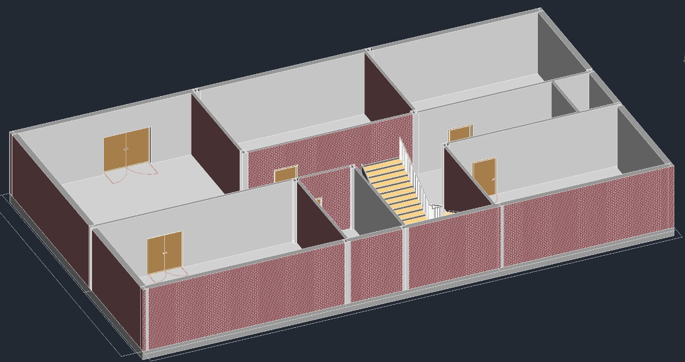
Club House Ground Floor 3D

Slide 17
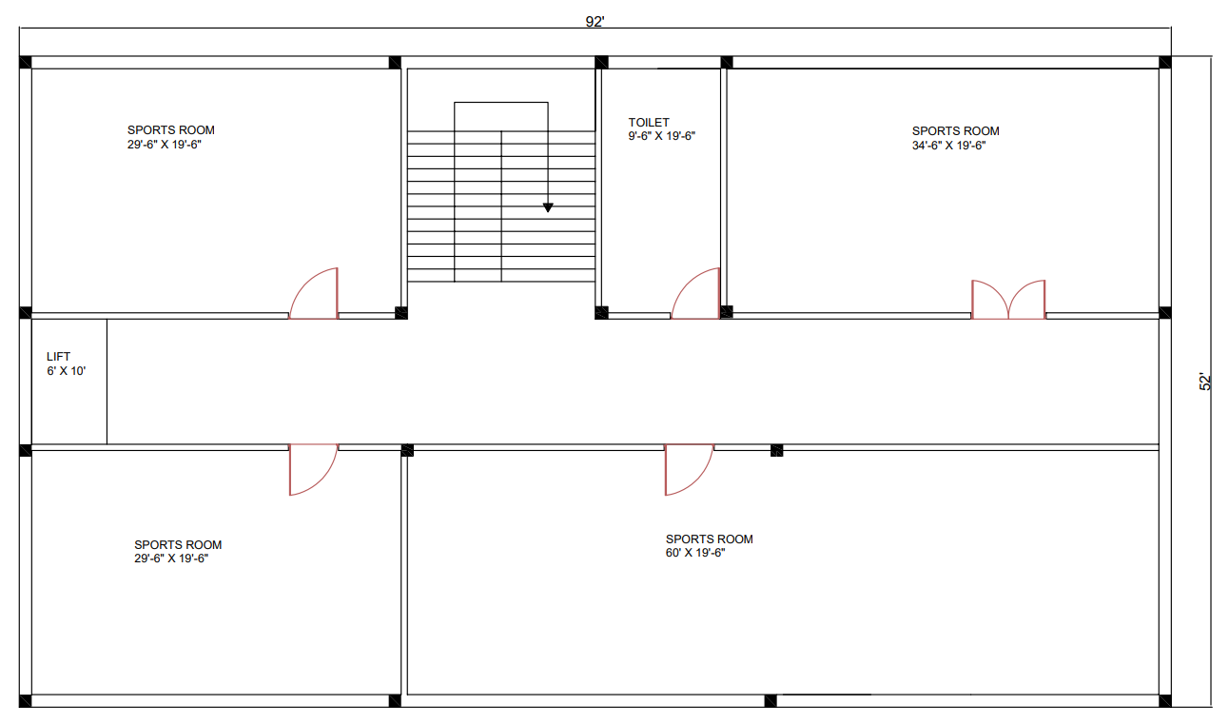
Club House First Floor 2D

Slide 18
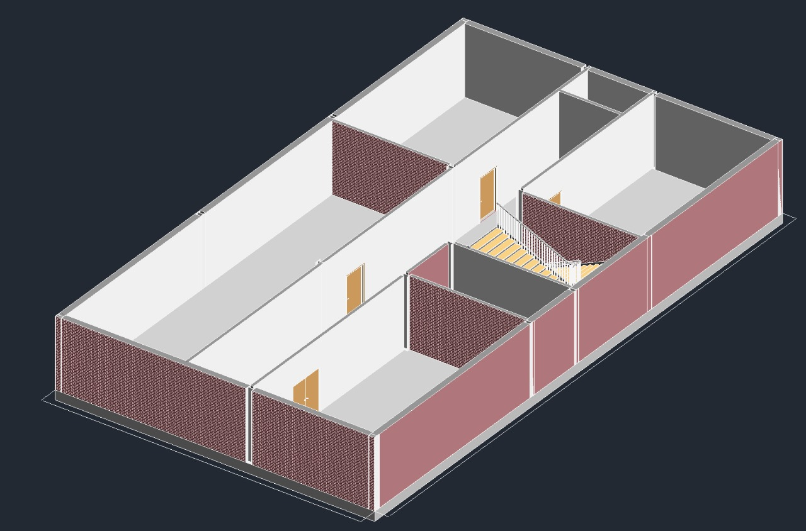
Club House First Floor 3D

Slide 19
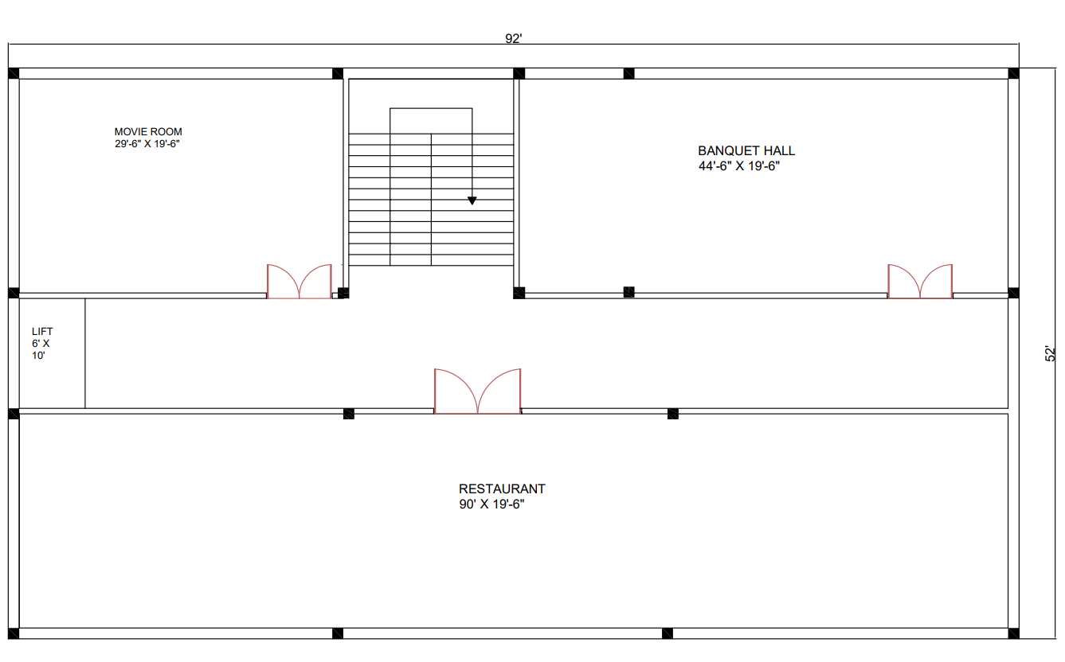
Club House Second Floor 2D

Slide 20
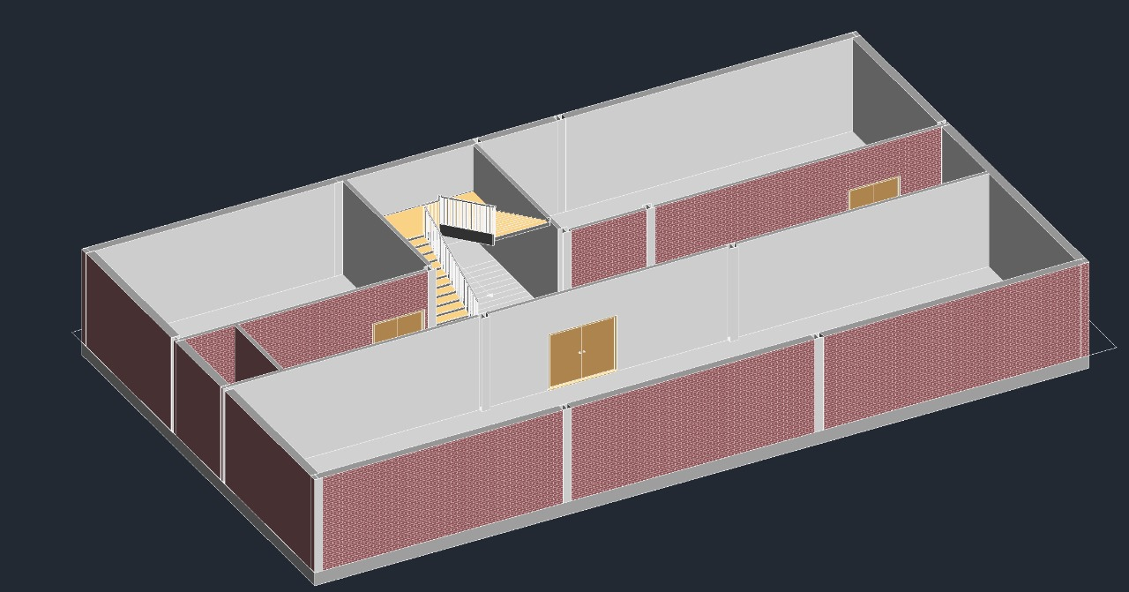
Club House Second Floor 3D

Slide 21
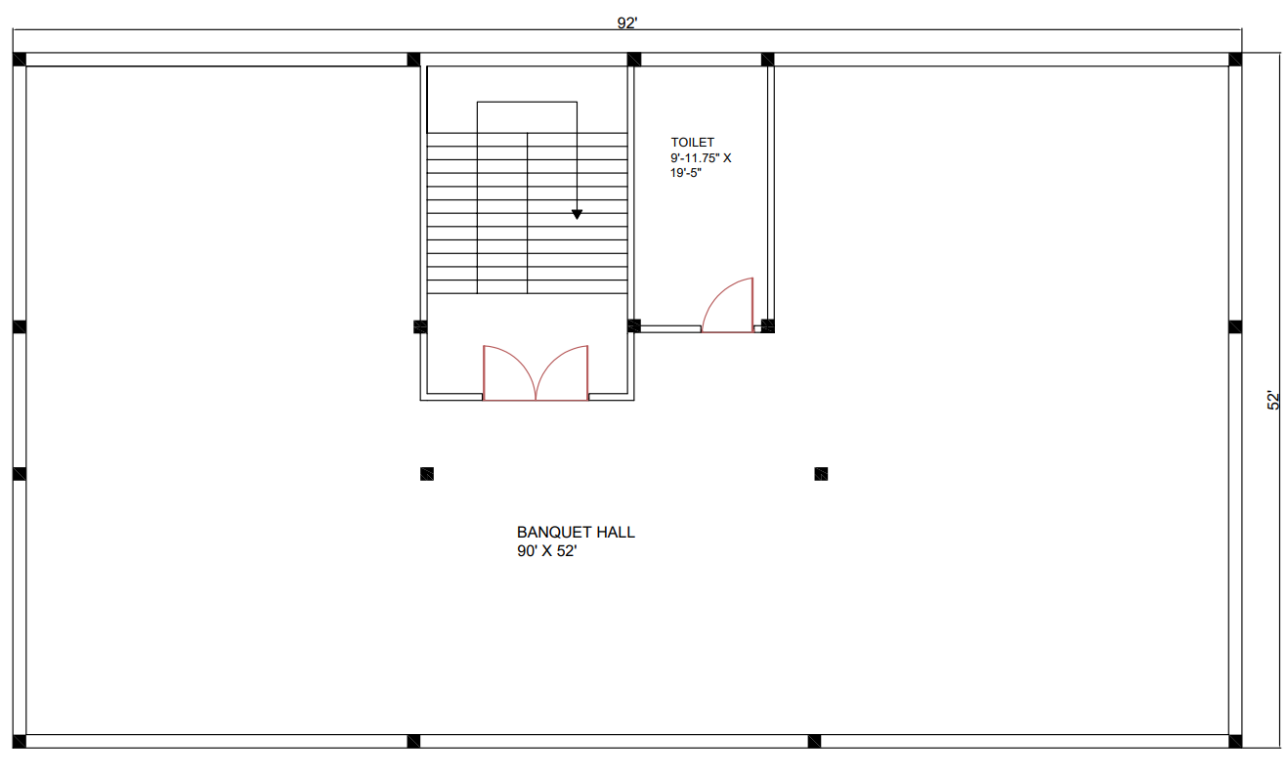
Club House Third Floor 2D

Slide 22
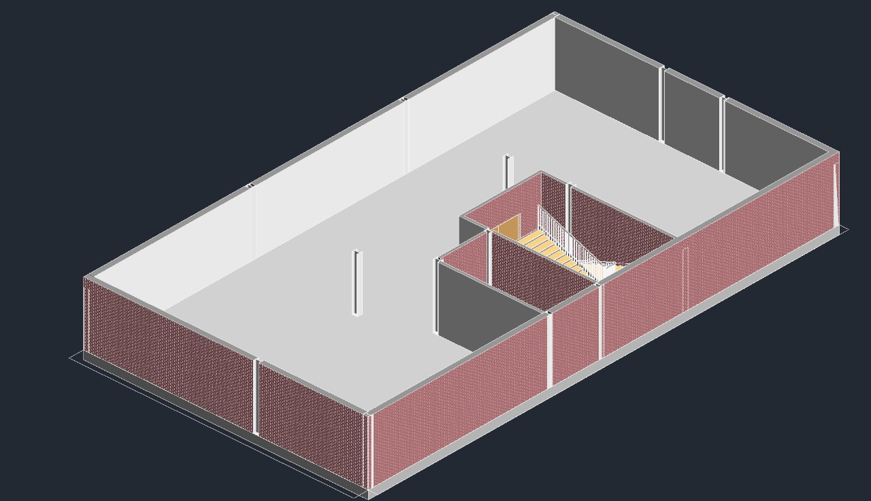
Club House Third Floor 3D

Slide 23
MULTILEVEL PARKING
We have given separate 11 Floors of Multilevel parking , because each floor consist of 8 Houses and a tower has 24 floors which 175’ 3” X 64’3” cannot sufficient for parking of all vehicles although we had given ground floor for two Wheeler parking.
In multilevel parking we planned a electric charging facility , because in now a days EV vehicles are increasing.
We have given a Electrical unit in each floor and main Electrical section in ground floor.
In ground floor we have provided Security , Main Electrical unit and Maintenance.

Slide 24
Total Effective area of Building is 45,000 sq.ft
Assuming each vehicle size atmost 180 sq.ft
An average of 250 vehicle in one floor
Total number of vehicle with a safety limit of 200 vehicle with capacity of 2500 vehicle

